Slide 1
Sporting Events System(SES)
Team 1
Amabel Yeo [Players, Teams]
Arnold Liu [Tournaments, Matches]
Axel Lim [Fields]
Aubrey Quek [Tickets]

Slide 2
Project Abstract
SES is an application which allows users to manage various sporting events.
Users can:
Manage teams and players
Manage tournaments and matches
Manage fields
Manage tickets

Slide 3
Project Goals
Prove the application of concepts learnt and practice by applying to a project as a team.
Understand requirements, visualize them using UML diagrams, develop the requirements and verify them by testing.
Use distributed version control system for developing the project as a team.
Apply various libraries, frameworks and tools.
Create a simple working prototype, and follow an iterative fashion to make the prototype better and apply best practices.
Implement a loosely-coupled, highly reusable code and integrate all the modules developed from day 1 of the training.
Develop the project in parallel with the sessions.
Explore the docs and observe different patterns in code.
Integrate the code written by the members of the team.

Slide 4
Design & Understanding Requirements
Using uml diagrams to:
visualize designs
Understand requirements

Slide 5
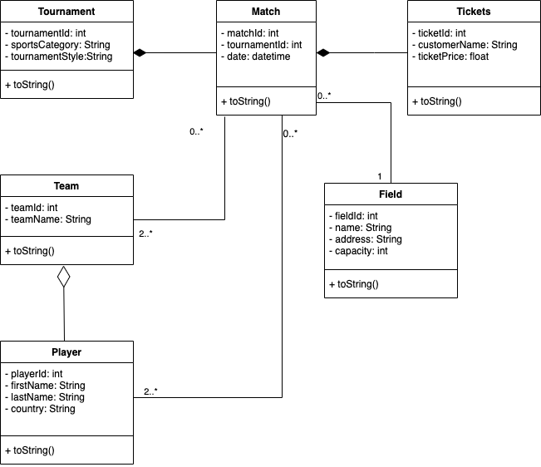
Class Diagram

Slide 6
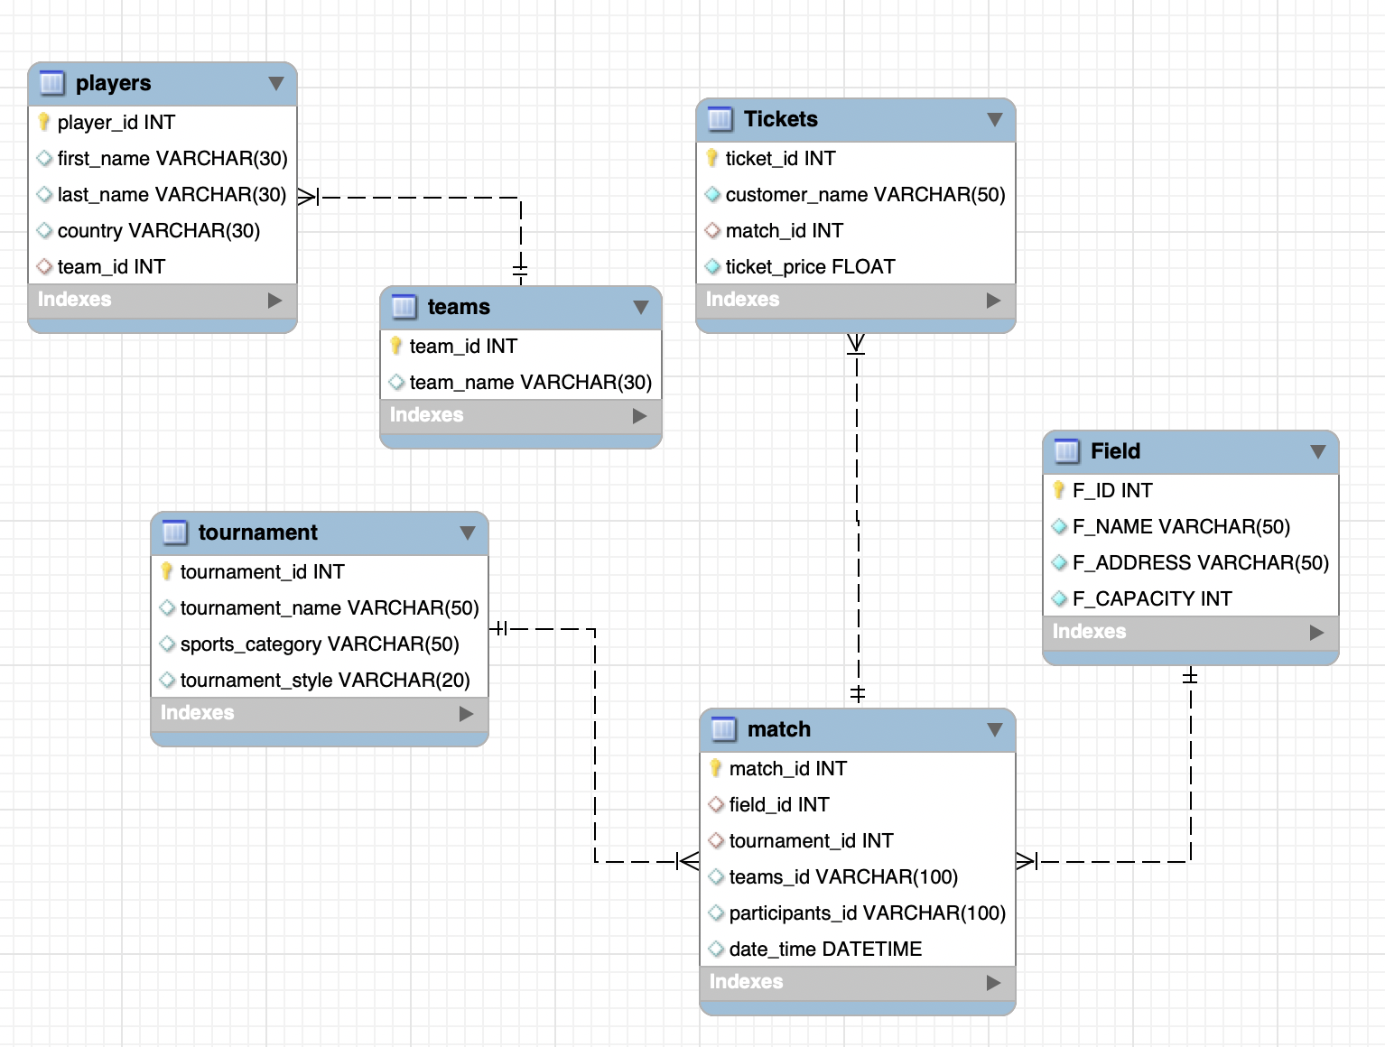
ER Diagram

Slide 7
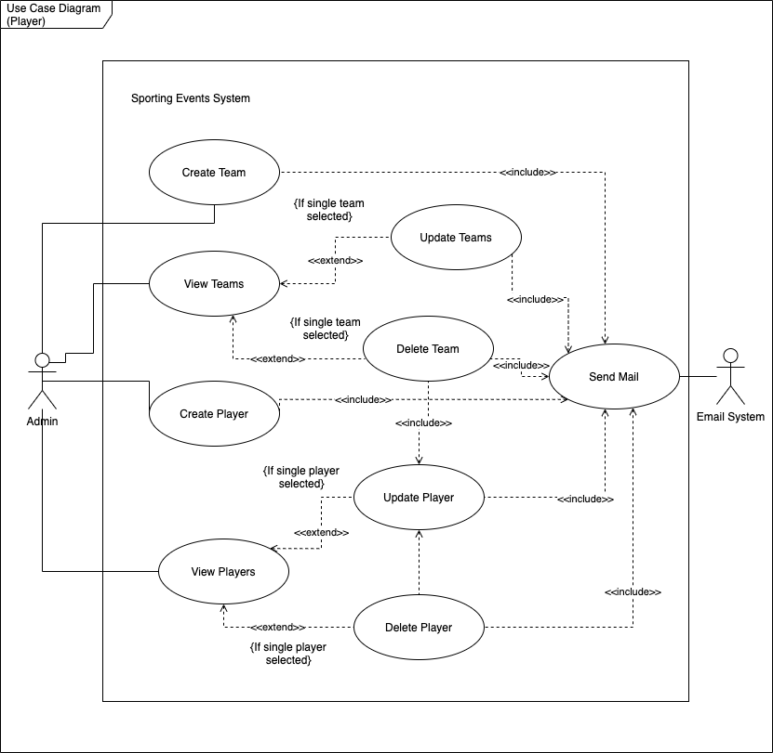
Use Case Diagram

Slide 8
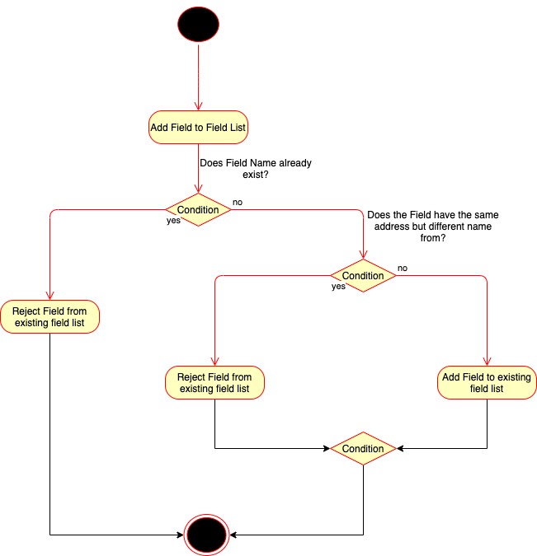
Start symbol
Activity symbol
Connector symbol
Decision symbol
Activity Diagram

Slide 9
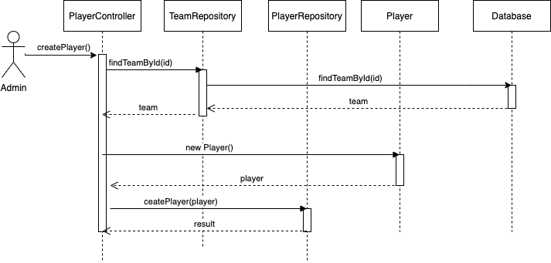
Sequence Diagram

Slide 10
Layered Architecture
UI Layer
Controller layer
service layer
Repo layer

Slide 11
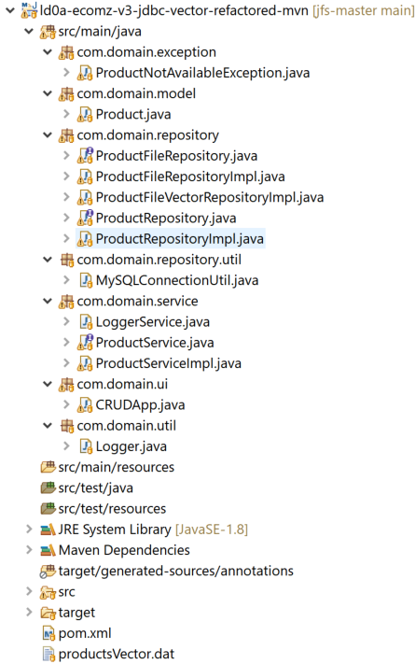
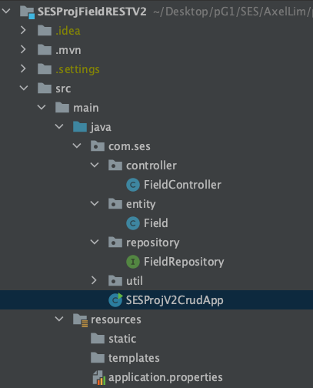
Layered Architecture implemented with Maven.
3 different repositories
FileRepository
Repository with Collections
(Repository connected to mysql later on)

Slide 12
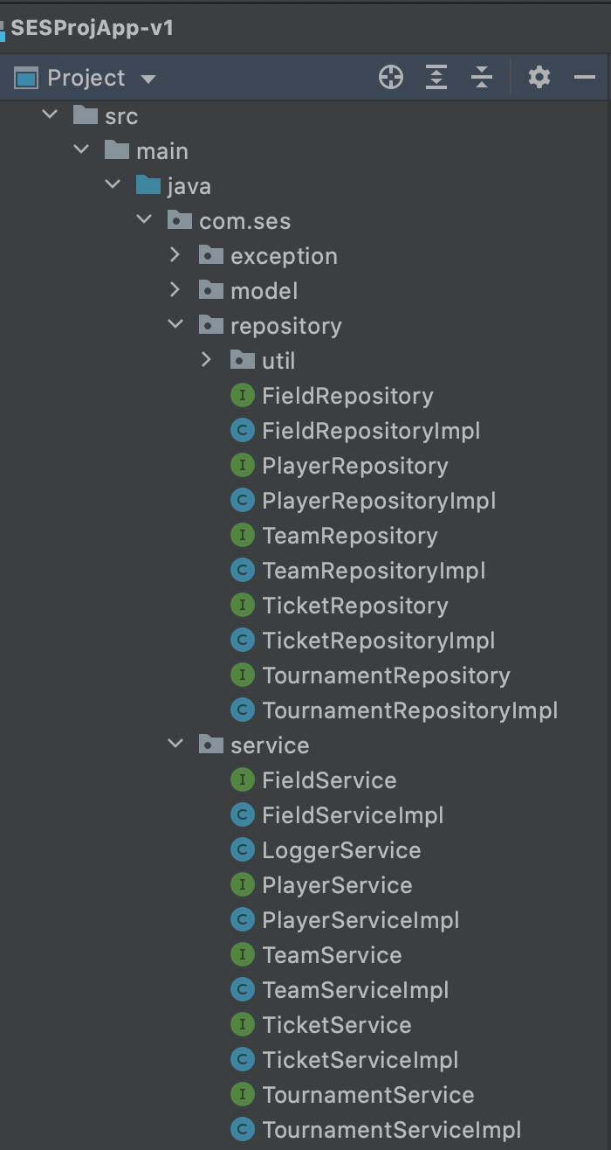
Layered Architecture (Maven) – JDBC Project
All Modules with their repositories

Slide 13
Testing
Testing with junit

Slide 14
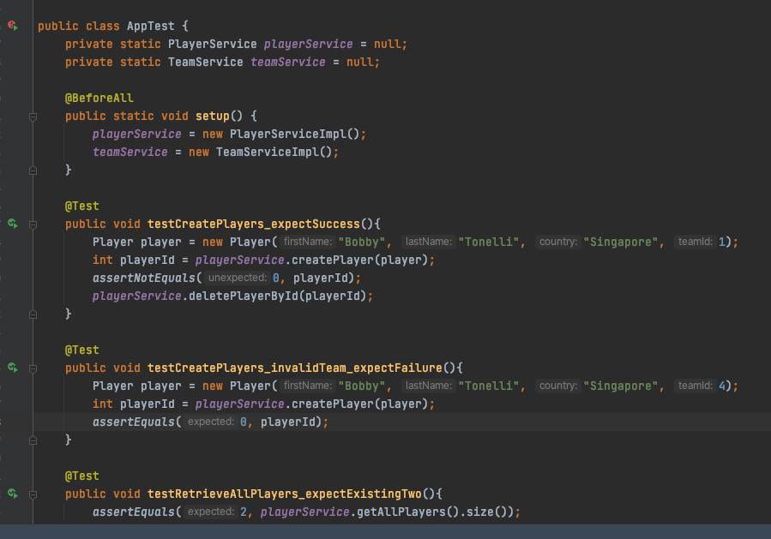
Junit testing done for App
Learnt how to use different annotations to run tests
Learnt assertions

Slide 15
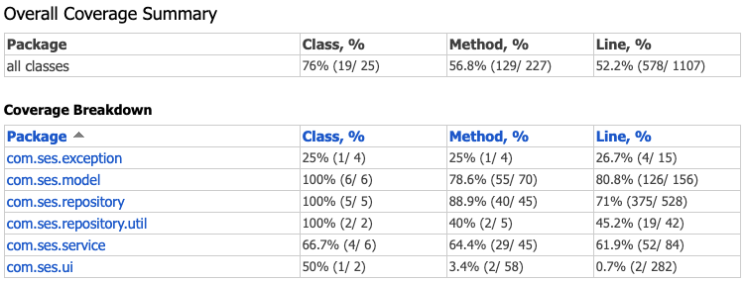
TDD with JUNIT5
JCOCO

Slide 16
Frameworks (Spring Core)
XML Config
Annotation Config
Java config

Slide 17
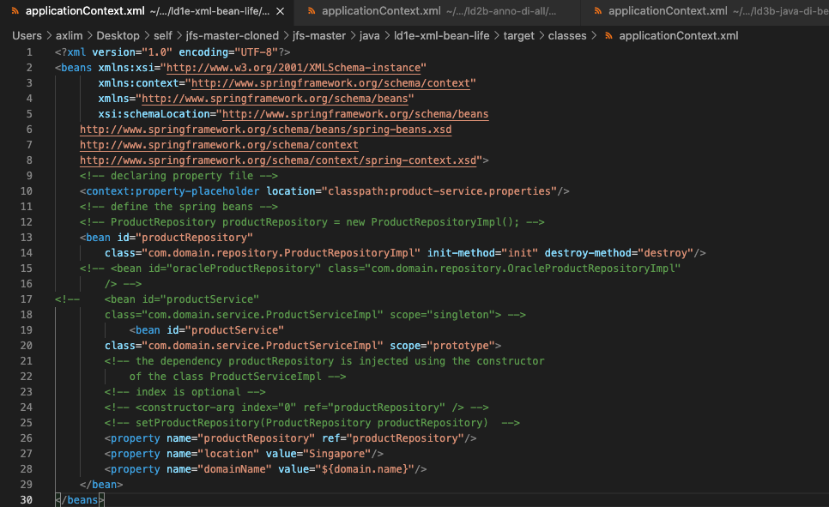
Progressively learning configuration methods
Configuration was done purely via XML -> “XML Developers”

Slide 18
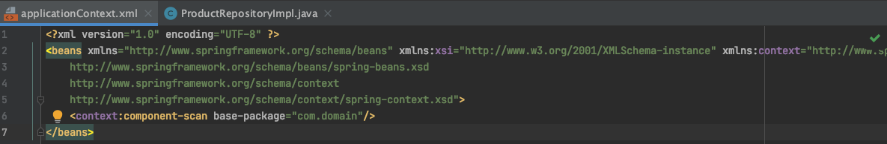
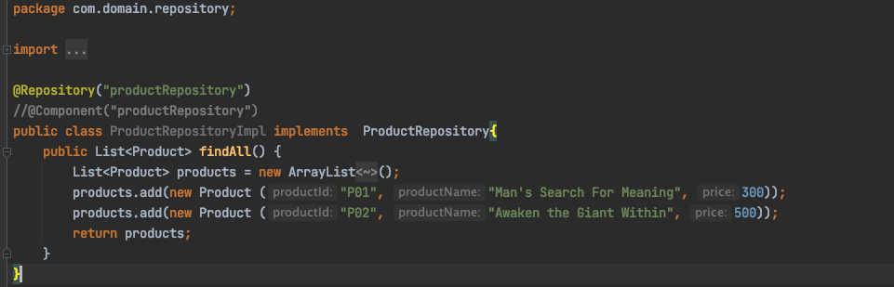
Configuration via Annotations
Less XML, more annotations

Slide 19
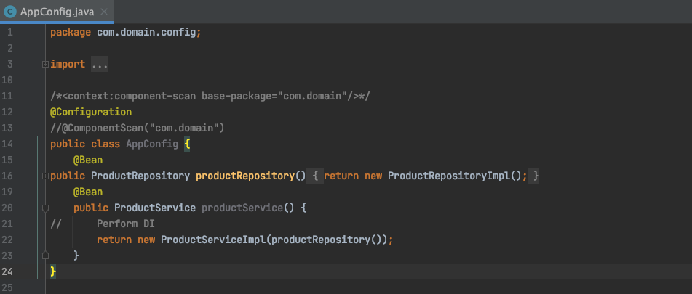
Configuration via Java
No XML, configuration done via Java class with @Configuration annotation

Slide 20
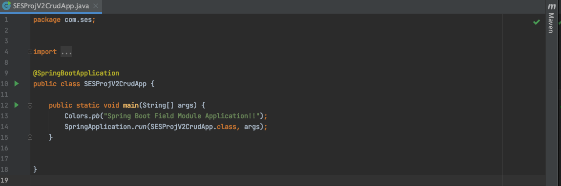
Auto Configuration with Spring Boot
Automated configuration using SpringBoot, without the need for applicationContext.XML nor a Java configuration Class.
Configuration achieved solely using annotations and Spring Boot dependency

Slide 21
Modular Projects of Each Team Member
JDBC Project
Spring JDBC Project
REST Project
SESProject

Slide 22
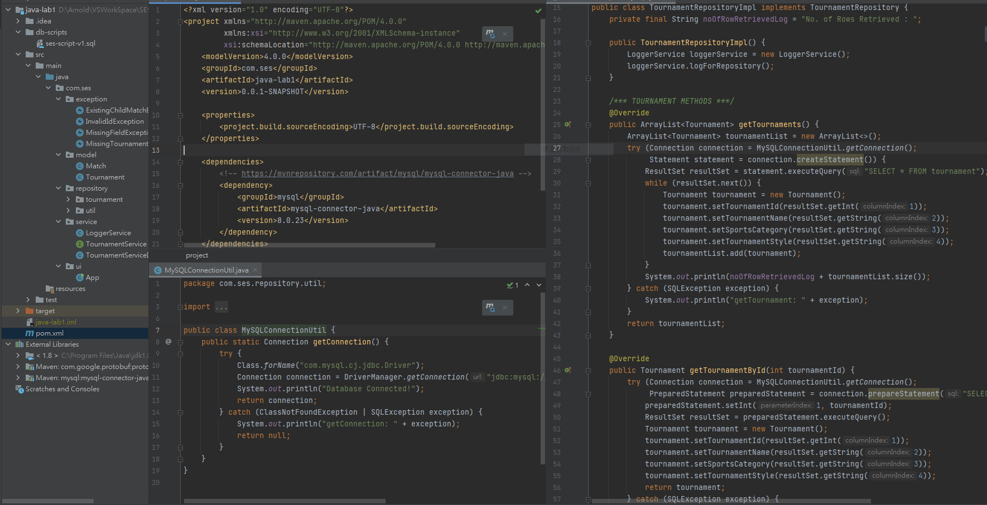
Modular JDBC Project
Module: Match

Slide 23
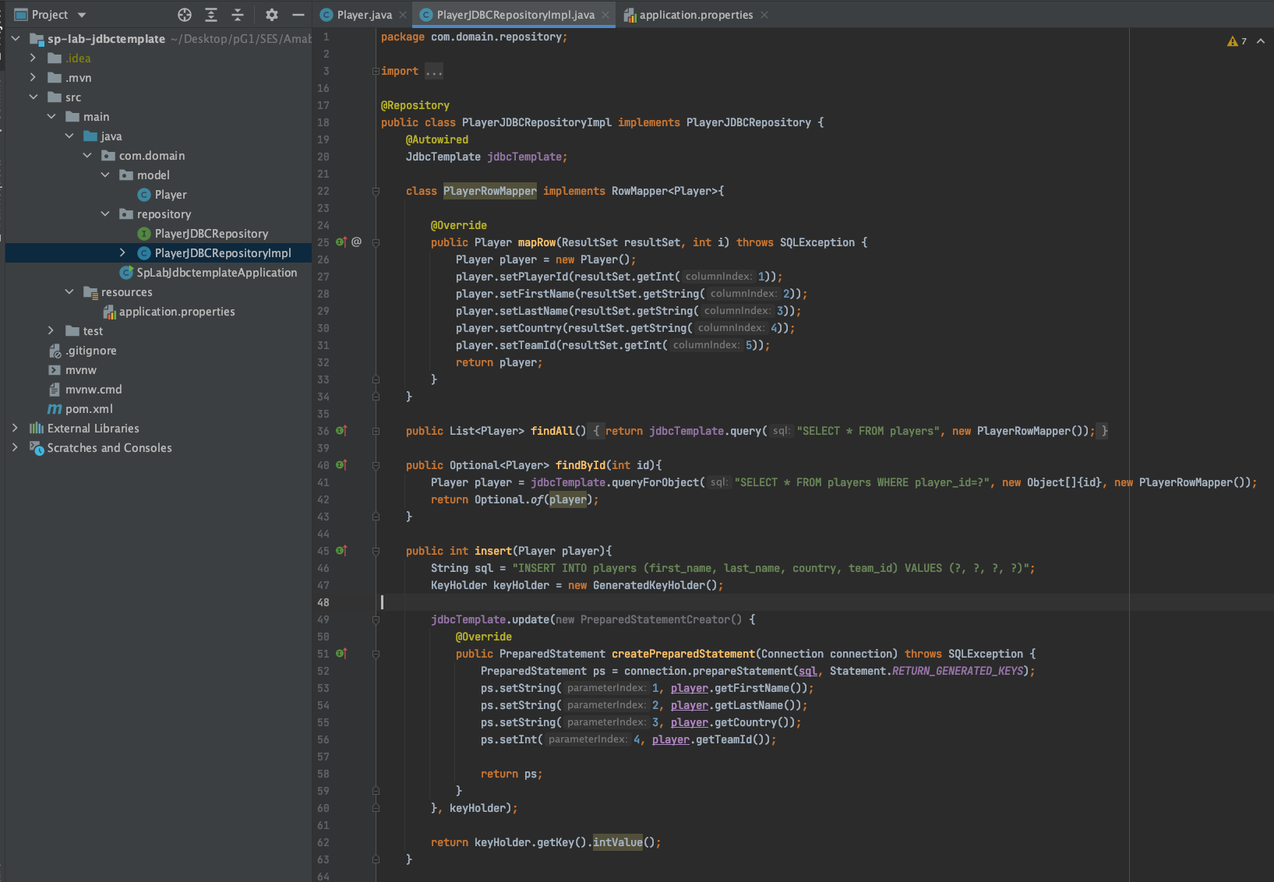
Spring JDBC Modular Project
Module: Player

Slide 24
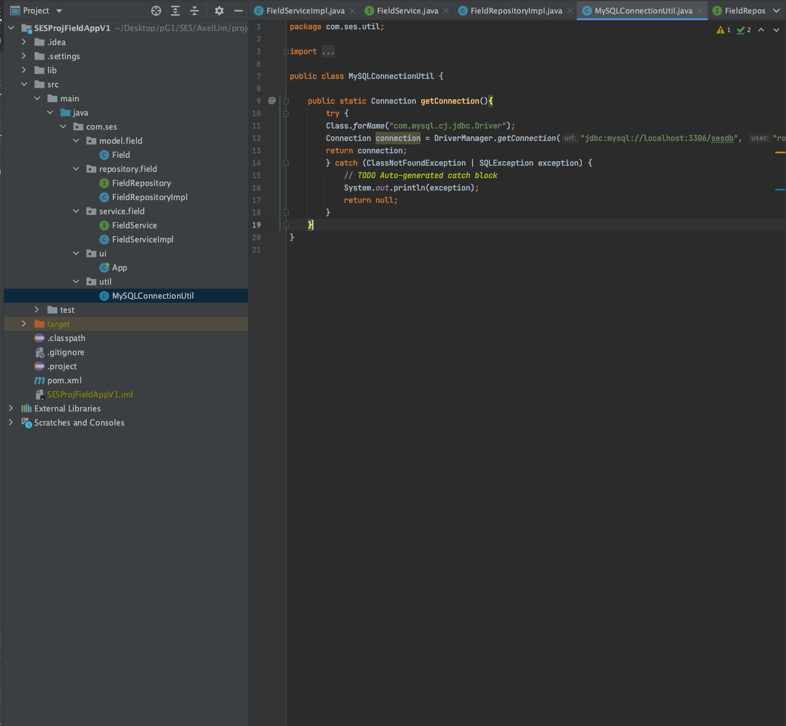
Modular SES Project
Module: Field

Slide 25
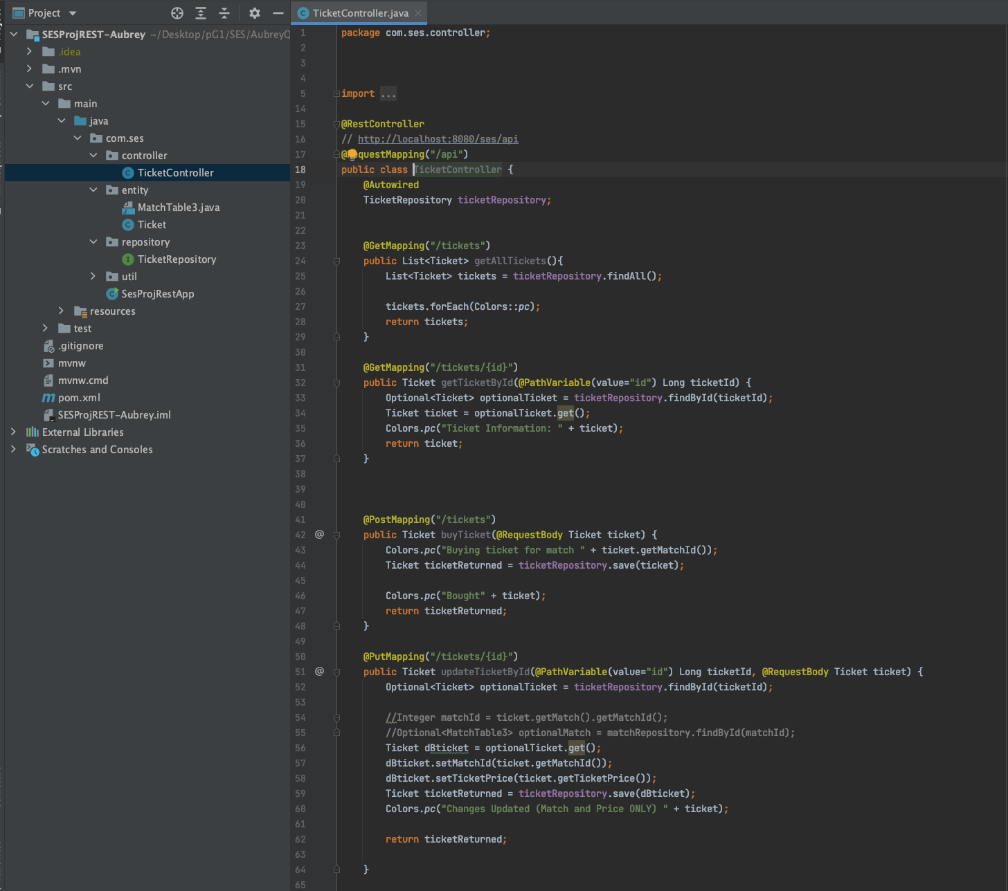
REST Modular project
Module: Ticket

Slide 26
Git & GITHUB
In teams of 4, we had to work on the same project within the same repository.
It has taught us to coordinate our efforts well to prevent major conflicts regarding code base changes.
Especially on modules, integrated projects where more than 1 individual may work on the same file at once.

Slide 27

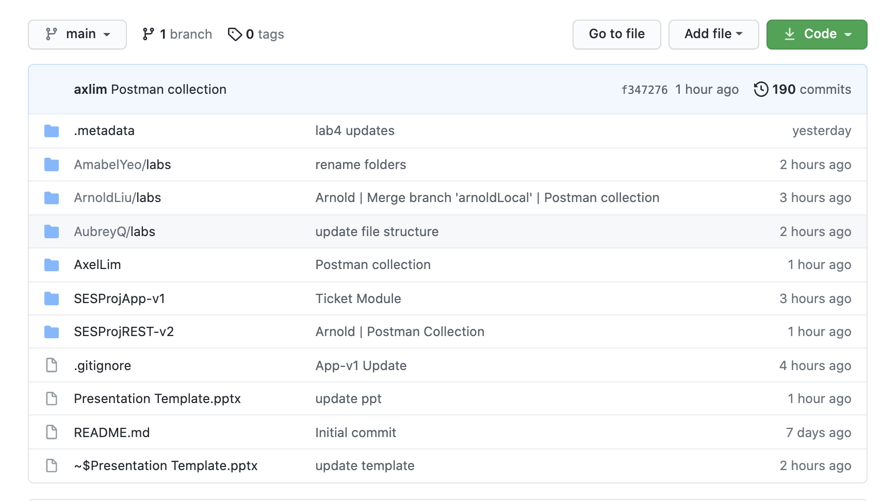
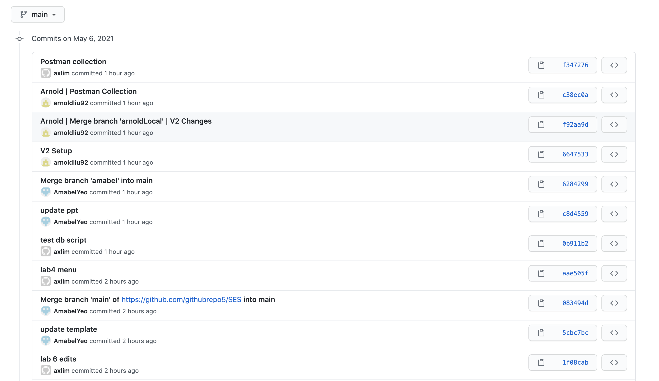
Screen shots
Collaboration of projects and sharing of exercises are done through Git and Github to help with version control and integration.

Slide 28
Learning & Experiences
The pace was well adjusted to accommodate new learners
Each topic was taught in detail with ample examples
There were enough exercises to practice the things taught
The details on configurations and set-ups were also emphasize well
The instructor was able to address our individual concerns and guided the participants in troubleshooting various issues
Learning to build a small application in a business context from the scratch was fulfilling and help us further understands the concepts taught during the trainings
The instructor kept track of our progress and consistently get our feedbacks to adjust his pace and gave us more explanations
The testing topics were helpful and emphasize the importance of it in development
To conclude, the training was accommodating and enjoyable with the instructor taking measures to ensure that we are all engaged and able to take away learning bits regardless of our prior experiences.

Slide 29
Thank you!

